Slide 1
PES’s Modern College of Arts, Science and Commerce, Ganeshkhind pune-16
FY BSc Data Science
Guided By : Dr. Dipali Meher Mam
Abhishek Ubale Sir
Team Members: Mr. Raviraj Nawle
Mr. Krishna Hiwale
Ms. Kasturi Bhuvad

Slide 2





Understanding Personalized Learning Data Analysis
Welcome! This presentation offers a step-by-step guide to data processing and uncovering AI insights for personalized learning. We'll explore how to gather, clean, visualize, and analyze student data to create effective learning experiences. Let's dive in and transform raw data into actionable intelligence. Get ready to empower education with the magic of data science!
KH

Slide 3








Making a Safe Copy & Checking for Missing Info
Code Snippet
Explanation
Use the .copy() method to create a duplicate DataFrame for safe manipulation, ensuring the original data remains unchanged. .isnull().sum() identifies and quantifies missing values in each column, guiding subsequent data cleaning strategies.
Personalized = learning_2.copy() Personalized.isnull().sum()

Slide 4





Removing Useless Columns & Fixing Missing Data
Fill Numerical
Replace missing numerical values using the median. This maintains data integrity by using a measure of central tendency.
2
Drop Unnamed
Removed columns with names like "Unnamed" as they often contain no useful information and clutter the dataset.
1
Fill Categorical
Impute missing categorical values using the mode. This ensures that categorical data remains complete and representative.
3

Slide 5



Converting Words to Numbers
Label Encoding
Encoding Gender
Label Encoding transforms categorical data into numerical format, essential for machine learning algorithms. It assigns a unique integer to each category.
To convert the "Gender" column, initiate LabelEncoder. Next, apply the fit_transform method to convert gender categories (e.g., male, female) into numerical labels (e.g., 0, 1).

Slide 6
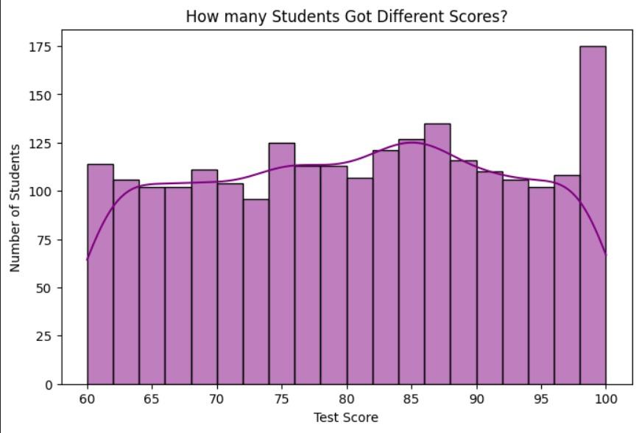
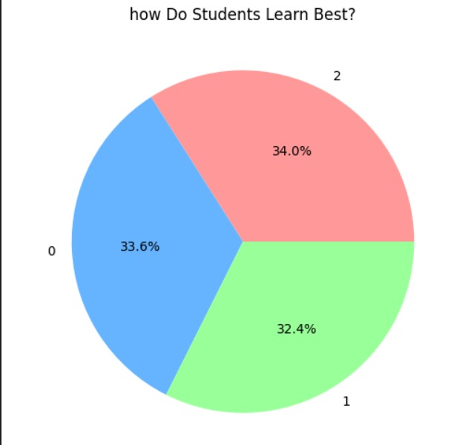



Creating Visual Stories

Slide 7
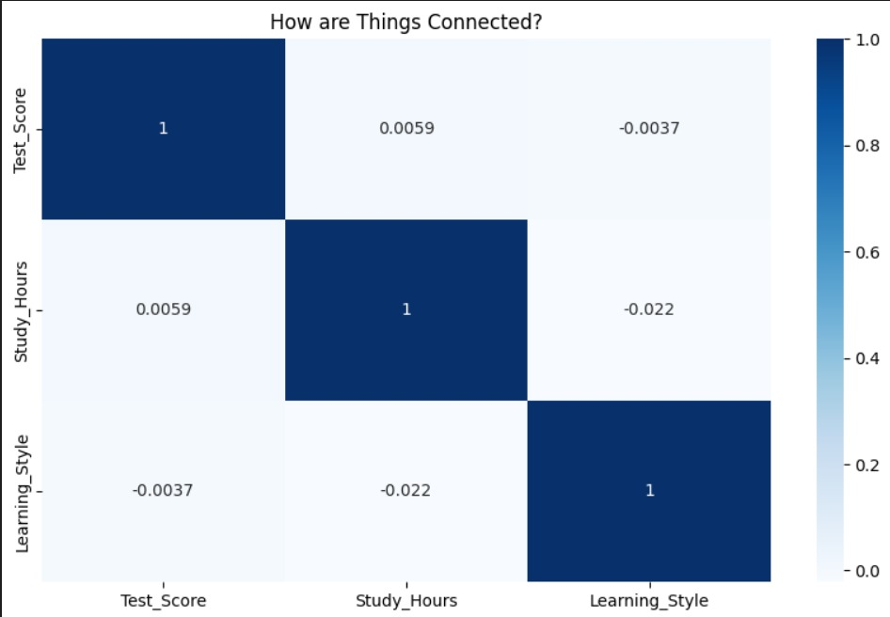
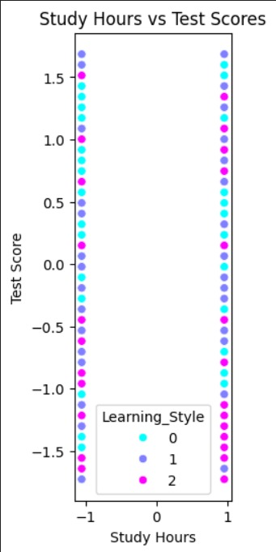

Slide 8




Building Smart Predictors
1
Regression
rf_regressor = RandomForestRegressor() rf_regressor.fit(X_train, y_train)
The RandomForestRegressor predicts continuous values (e.g., test scores) based on features like study hours. The fit method trains the model on the training data, learning relationships between features and scores.
2
Classification
rf_classifier = RandomForestClassifier()
The RandomForestClassifier predicts categorical outcomes (e.g., course selection) based on student characteristics. The fit method trains the model on the training data, learning associations between features and subjects.

Slide 9

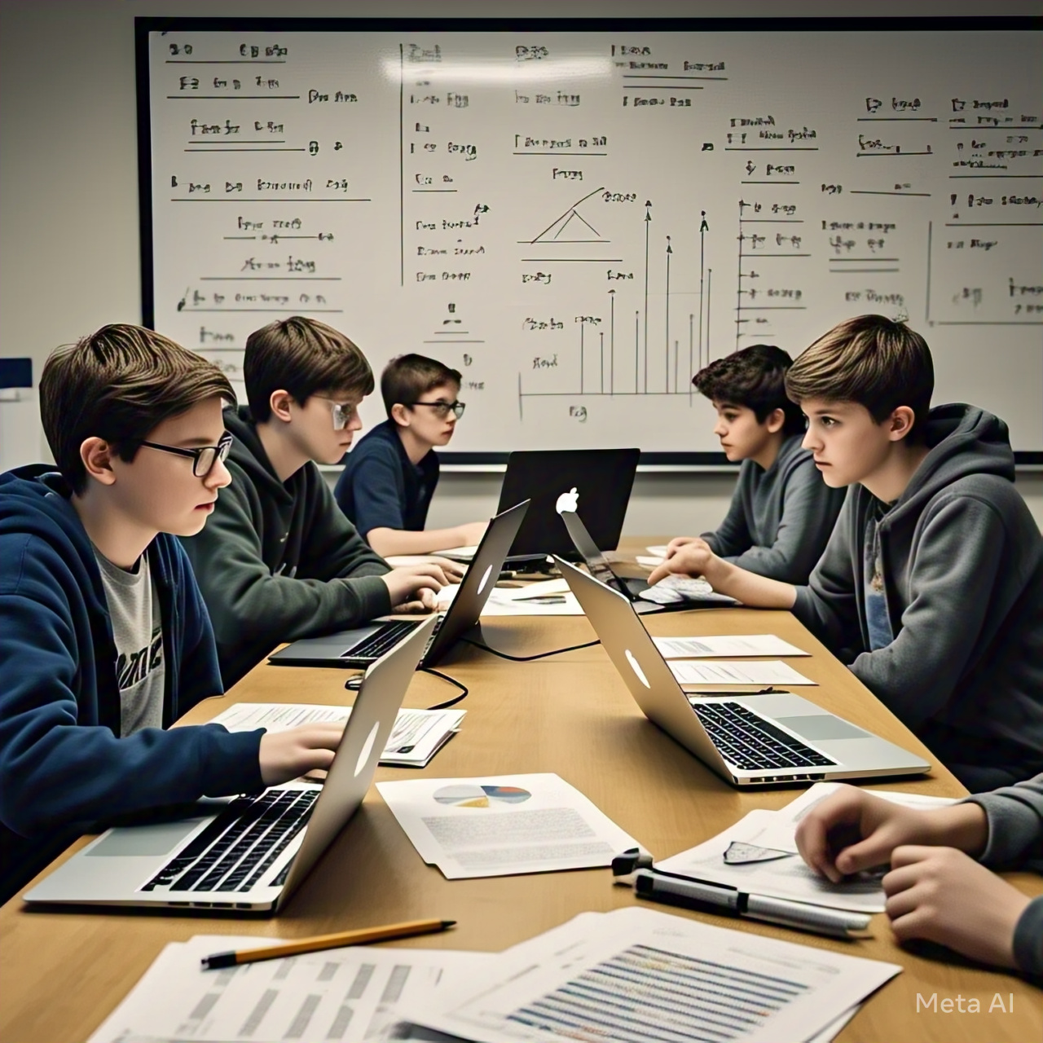


Understanding Key Factors
Feature Importance
feature_importances.plot()
Plot feature importances to reveal which study habits most influence test scores. This visualization aids in understanding key factors driving student performance.

Slide 10



Outcomes
MSE : 0.061
RMSE : 0.248
R^2 Score : 0.941
Accuracy : 0.766
From This values We can interpret that Our model can be considered reliable. Having a Accuracy 76% interprets that if a student has a learning style of visual and he studies for 5 hours, he will score above 70. We can improve this model by increasing the accuracy upto 90 to 95% where this will more reliable. We are having lower MSE and RMSE Score which means our model is good also our R^2 Score is close to 1 this also means model is reliable.

Slide 11



.
tuning for better pe
Future Directions and Recommendations for Educational Data Analysis
XGBoost / LightGBM – Boosted tree-based models for predicting student performance more accurately.
Neural Networks (MLPs, LSTMs, Transformers) – Deep learning for complex, sequential learning data.
Reinforcement Learning – Adaptive learning paths based on student engagement and performance.
AutoML (TPOT, H2O.ai) – Automates model selection and hyperparameter tuning for better performance.

Slide 12



Questions & Discussion
Thank you for your time. We are able to answer your questions if any.

Slide 13
References
DeepSeek. (n.d.). Retrieved from https://deepseek.com
Perplexity AI. (n.d.). Retrieved from https://www.perplexity.ai
Google. (n.d.). Retrieved from https://www.google.com
OpenAI. (2024). ChatGPT. Retrieved from https://openai.com/chatgpt
Blackbox AI. (n.d.). Retrieved from https://www.blackbox.ai
Quadratic. (n.d.). Retrieved from https://www.quadratic.com
Kaggle. (n.d.). Retrieved from https://www.kaggle.com
Gamma. (n.d.). Retrieved from https://gamma.app
Art. (n.d.). Retrieved from https://www.imagine.art
Meta AI. (n.d.). Retrieved from https://ai.meta.com
Random Forest Algorithm from https://www.geeksforgeeks.org/random-forest-algorithm-in-machine-learning/

